Slide 1


CSB4201 - DESIGN AND ANALYSIS AND ALGORITHMS
B.Tech – III Semester – Unit II
Mr.M.Sambath
Assistant Professor
School of Computing Sciences,
Department of Computer Science and Engineering

Slide 2
Lecture 13 Topic : Brute force

Slide 3
A straightforward approach, usually based directly on the problem’s statement and definitions of the concepts involved Examples: Computing n! Multiplying two matrices Searching for a key of a given value in a list
BRUTE FORCE

Slide 4
Lecture 13 Topic : Travelling Salesman Problem

Slide 5
Cont.
Given n cities with known distances between each pair, find the shortest tour that passes through all the cities exactly once before returning to the starting city
Alternatively: Find shortest Hamiltonian circuit in a weighted connected graph

Slide 6
Cont.
2
a
b
5
3
8
4
c
d
7

Slide 7
Cont.
2
a
b
5
3
Tour Cost
a→b→c→d→a 2+3+7+5 = 17
a→b→d→c→a 2+4+7+8 = 21
a→c→b→d→a 8+3+4+5 = 20
a→c→d→b→a 8+7+4+2 = 21
a→d→b→c→a 5+4+3+8 = 20
a→d→c→b→a 5+7+3+2 = 17
Efficiency: Θ((n-1)!)
4
8
c
d
7

Slide 8
Activity https://visualgo.net/en

Slide 9
Lecture 14 Topic : Knapsack Problem

Slide 10
Given n items: weights: w₁ w₂ … w_{n} values: v₁ v₂ … v_{n} a knapsack of capacity W Find most valuable subset of the items that fit into the knapsack Example: Knapsack capacity W=16 item weight value 1 2 $20 2 5 $30 3 10 $50 4 5 $10

Slide 11
Subset Total weight Total value {1} 2 $20 {2} 5 $30 {3} 10 $50 {4} 5 $10 {1,2} 7 $50 {1,3} 12 $70 {1,4} 7 $30 {2,3} 15 $80 {2,4} 10 $40 {3,4} 15 $60 {1,2,3} 17 not feasible {1,2,4} 12 $60 {1,3,4} 17 not feasible {2,3,4} 20 not feasible {1,2,3,4} 22 not feasible Efficiency : O(2^n)

Slide 12
Activity https://visualgo.net/en

Slide 13
Lecture 14 Topic : Assignment Problem

Slide 14
The Assignment Problem: There are n people who need to be assigned to n jobs, one person per job. The cost of assigning person i to job j is C[i,j]. Find an assignment that minimizes the total cost. Job 1 Job 2 Job 3 Job 4 Person 1 9 2 7 8 Person 2 6 4 3 7 Person 3 5 8 1 8 Person 4 7 6 9 4 Algorithmic Plan: Generate all legitimate assignments, compute their costs, and select the cheapest one. How many assignments are there? n!

Slide 15
Job 1 Job 2 Job 3 Job 4
Person 1 9 2 7 8
Person 2 6 4 3 7
Person 3 5 8 1 8
Person 4 7 6 9 4
Assignment (col.#s) Total Cost
1, 2, 3, 4 9+4+1+4=18
1, 2, 4, 3 9+4+8+9=30
1, 3, 2, 4 9+3+8+4=24
1, 3, 4, 2 9+3+8+6=26
1, 4, 2, 3 9+7+8+9=33
1, 4, 3, 2 9+7+1+6=23
2, 1, 3, 4 2+6+1+4 = 13
etc.
(For this particular instance, the optimal assignment can be found by exploiting the specific features of the number given. It is: )

Slide 16
Divide-and-Conquer
The most-well known algorithm design strategy:
Divide instance of problem into two or more smaller instances
Solve smaller instances recursively
Obtain solution to original (larger) instance by combining these solutions

Slide 17
Divide-and-Conquer Technique (cont.)
a problem of size n
(instance)
subproblem 1
of size n/2
subproblem 2
of size n/2
a solution to
subproblem 1
a solution to
subproblem 2
a solution to
the original problem
It general leads to a recursive algorithm!

Slide 18
Divide-and-Conquer Examples
Sorting: mergesort and quicksort
Binary tree traversals
Binary search (?)
Multiplication of large integers
Matrix multiplication: Strassen’s algorithm
Closest-pair and convex-hull algorithms

Slide 19
General Divide-and-Conquer Recurrence
T(n) = aT(n/b) + f (n) where f(n) ∈ Θ(n^{d}), d ≥ 0
Master Theorem: If a < b^{d}, T(n) ∈ Θ(n^{d})
If a = b^{d}, T(n) ∈ Θ(n^{d} log n)
If a > b^{d}, T(n) ∈ Θ(n^{log b a} )
Note: The same results hold with O instead of Θ.
Examples: T(n) = 4T(n/2) + n ⇒ T(n) ∈ ?
T(n) = 4T(n/2) + n² ⇒ T(n) ∈ ?
T(n) = 4T(n/2) + n³ ⇒ T(n) ∈ ?
Θ(n^2)
Θ(n^2log n)
Θ(n^3)

Slide 20
Topic : Binary search

Slide 21
Binary Search
Very efficient algorithm for searching in sorted array:
K
vs
A[0] . . . A[m] . . . A[n-1]
If K = A[m], stop (successful search); otherwise, continue
searching by the same method in A[0..m-1] if K < A[m]
and in A[m+1..n-1] if K > A[m]
l ← 0; r ← n-1
while l ≤ r do
m ← ⎣(l+r)/2⎦
if K = A[m] return m
else if K < A[m] r ← m-1
else l ← m+1
return -1

Slide 22
Analysis of Binary Search
Time efficiency
worst-case recurrence: C_{w} (n) = 1 + C_{w}( ⎣n/2⎦ ), C_{w} (1) = 1 solution: C_{w}(n) = ⎡log₂(n+1)⎤ average case : log₂n

Slide 23
Activity https://visualgo.net/en

Slide 24
Lecture 16 Topic : Merge sort

Slide 25
Mergesort
Split array A[0..n-1] into about equal halves and make copies of each half in arrays B and C
Sort arrays B and C recursively
Merge sorted arrays B and C into array A as follows:
Repeat the following until no elements remain in one of the arrays:
compare the first elements in the remaining unprocessed portions of the arrays
copy the smaller of the two into A, while incrementing the index indicating the unprocessed portion of that array
Once all elements in one of the arrays are processed, copy the remaining unprocessed elements from the other array into A.

Slide 26
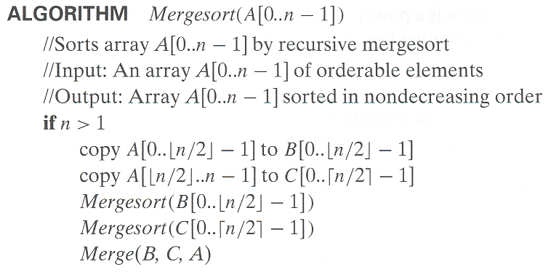
Pseudocode of Mergesort

Slide 27
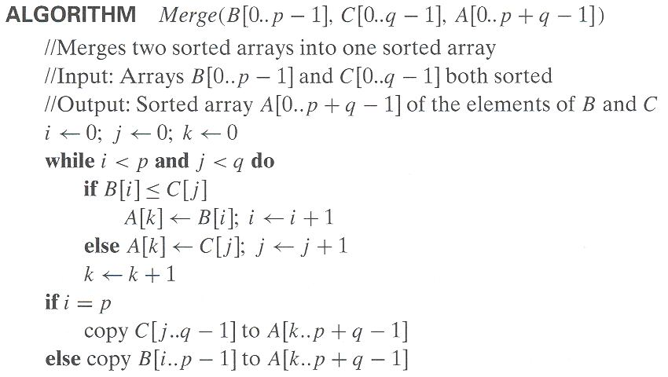
Pseudocode of Merge
Time complexity: Θ(p+q) = Θ(n) comparisons

Slide 28
Mergesort Example
The non-recursive version of Mergesort starts from merging single elements into sorted pairs.
Notes:
Go over this example in detail, then do another example of merging, something like:
(1 2 5 7 9)
(3 4 6)

Slide 29
Analysis of Mergesort
T(n) = 2T(n/2) + Θ(n), T(1) = 0
All cases have same efficiency: Θ(n log n)
Number of comparisons in the worst case is close to theoretical minimum for comparison-based sorting:
⎡log₂ n!⎤ ≈ n log₂ n - 1.44n
Space requirement: Θ(n) (not in-place)
Can be implemented without recursion (bottom-up)
Notes:
even if not analyzing in detail, show the recurrence for mergesort in worst case:
T(n) = 2 T(n/2) + (n-1)
worst case comparisons for merge

Slide 30
Activity https://visualgo.net/en

Slide 31
Lecture 17 Topic : Quick Sort

Slide 32
Quicksort
Select a pivot (partitioning element) – here, the first element
Rearrange the list so that all the elements in the first s positions are smaller than or equal to the pivot and all the elements in the remaining n-s positions are larger than or equal to the pivot (see next slide for an algorithm)
Exchange the pivot with the last element in the first (i.e., ≤) subarray — the pivot is now in its final position
Sort the two subarrays recursively
p
A[i]≤p
A[i]≥p

Slide 33
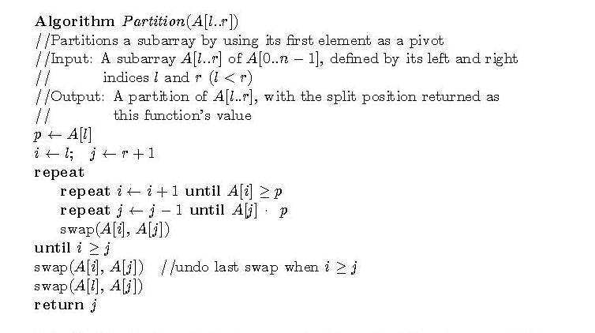
Partitioning Algorithm
or i > r
or j = l
<
Time complexity: Θ(r-l) comparisons

Slide 34
Quicksort Example
5 3 1 9 8 2 4 7
2 3 1 4 5 8 9 7
1 2 3 4 5 7 8 9
1 2 3 4 5 7 8 9
1 2 3 4 5 7 8 9
1 2 3 4 5 7 8 9

Slide 35
Analysis of Quicksort
Best case: split in the middle — Θ(n log n)
Worst case: sorted array! — Θ(n²)
Average case: random arrays — Θ(n log n)
Improvements:
better pivot selection: median of three partitioning
switch to insertion sort on small subfiles
elimination of recursion
These combine to 20-25% improvement
Considered the method of choice for internal sorting of large files (n ≥ 10000)
T(n) = T(n-1) + Θ(n)

Slide 36
Activity https://visualgo.net/en

